Slide 2
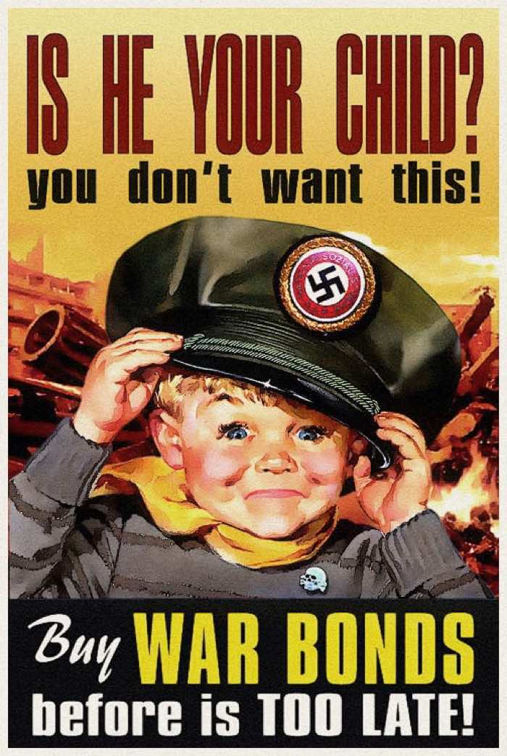
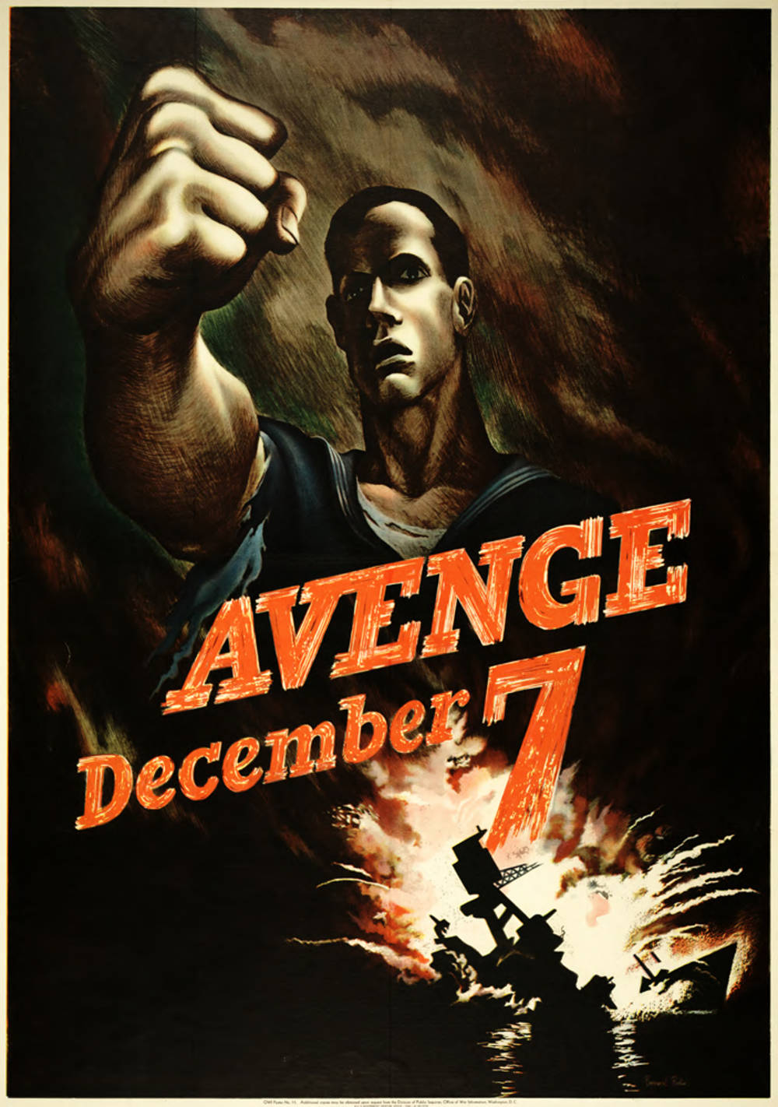

Slide 3
Historical Thinking skills Sourcing Close reading Corroboration Contextualization

Slide 4
Sourcing: Who made this document? When? Who was it made for? How was it made? How was it disseminated? What is its message or argument?

Slide 5
Sourcing Close reading: What choices did the creator of this document make? What do those choices say about the past? How might this document have looked different?

Slide 6
Sourcing Close reading Corroboration: What other texts appeared at this moment? How do they support or complicate this document? What do the disagreements tell us?

Slide 7
Sourcing Close reading Corroboration Contextualization: What was going on when this document appeared? How did those events affect its creation?

Slide 8
Historical Thinking skills Sourcing Close reading Corroboration Contextualization

Slide 9
Historical Thinking skills Sourcing Close reading Corroboration Contextualization

Slide 10
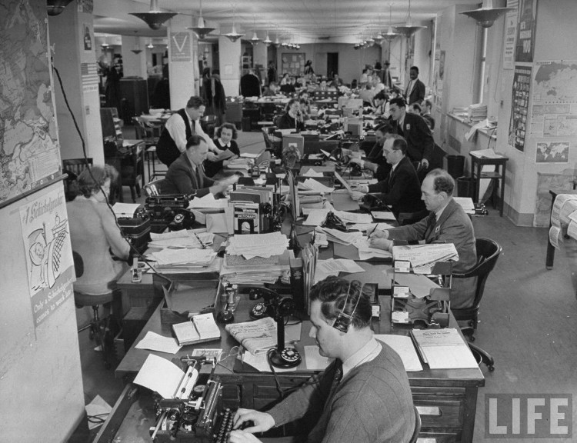

Slide 11
Sourcing Close reading: What choices did the creator of this document make? What do those choices say about the past? How might this document have looked different?

Slide 12
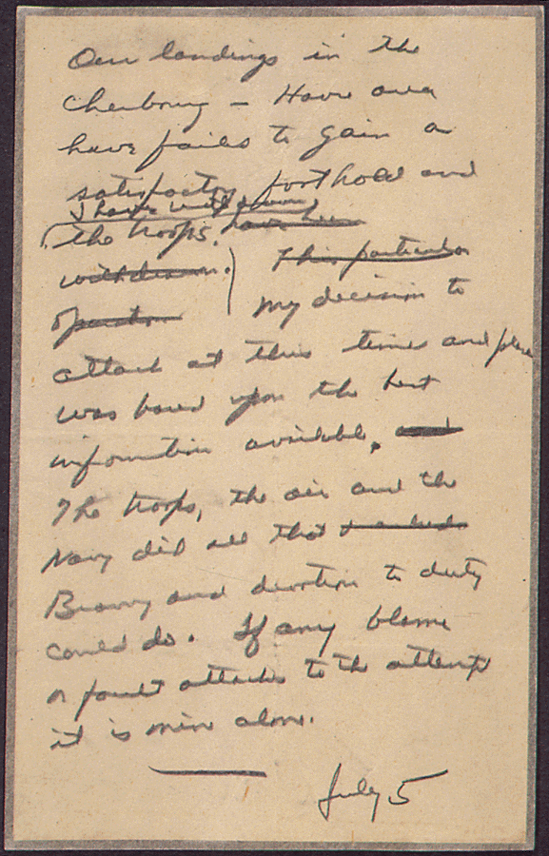

Slide 13
Our landings in the Cherbourg-Havre area have failed to gain a satisfactory foothold and the troops have been withdrawn I have withdrawn the troops.
This particular operation My decision to attack at this time and place was based upon the best information available.
The troops, the air and the navy did all that Bravery and devotion to duty could do. If any blame or fault attaches to the attempt it is mine alone.
July 5

Slide 14
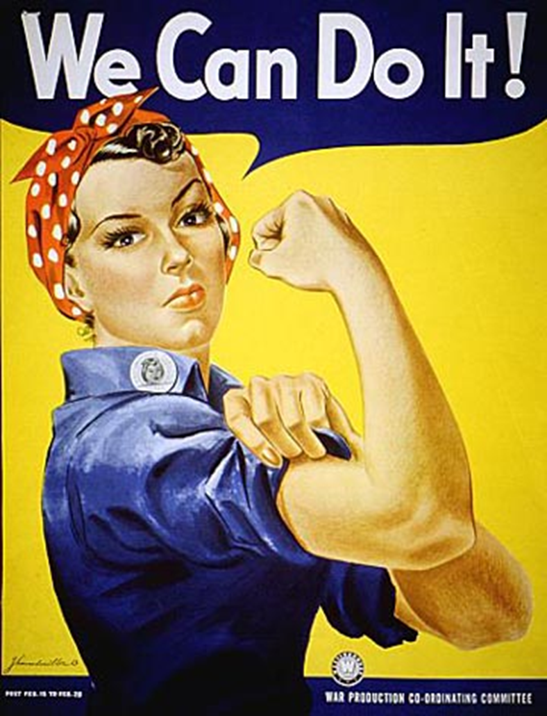

Slide 15
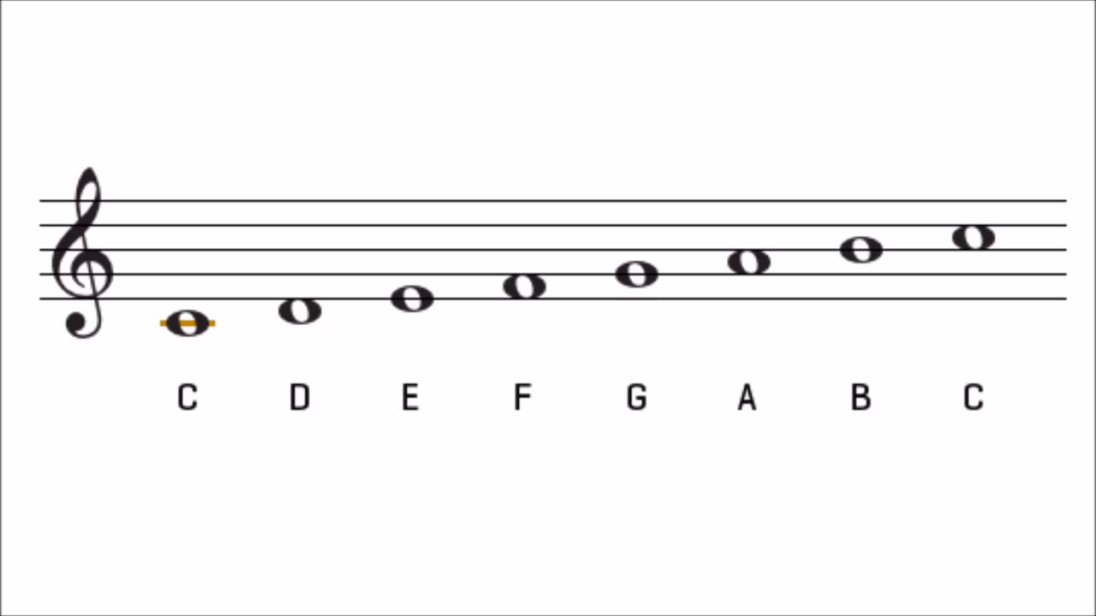

Slide 16
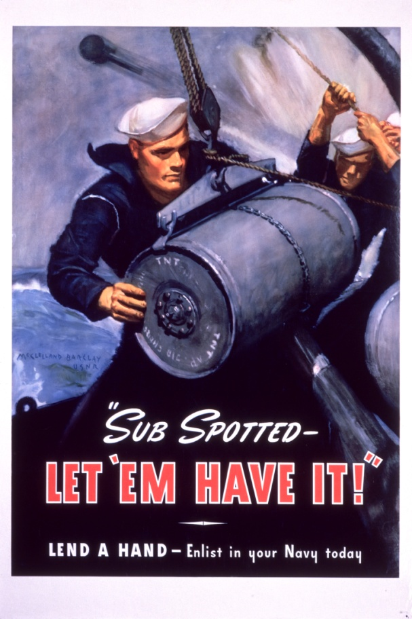
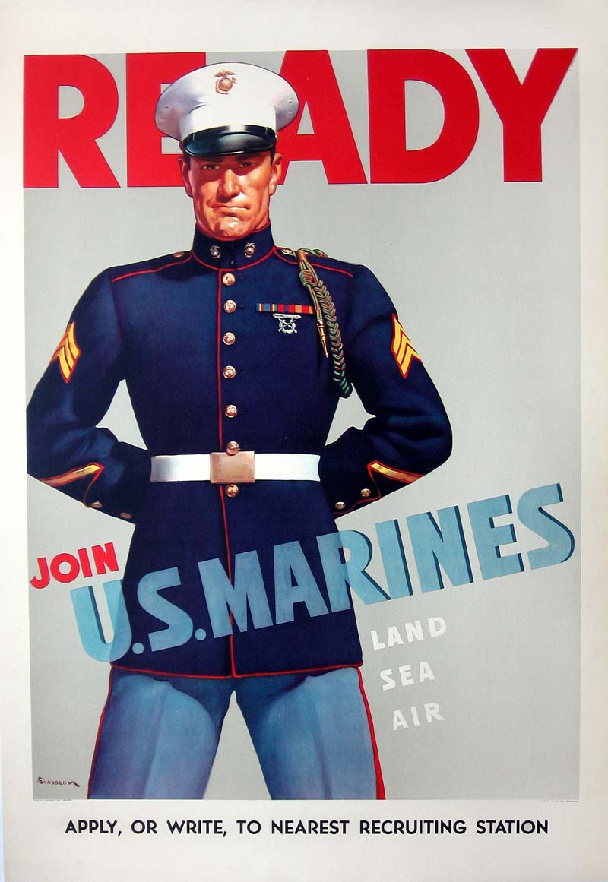
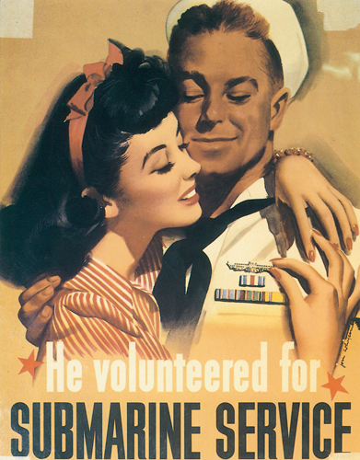
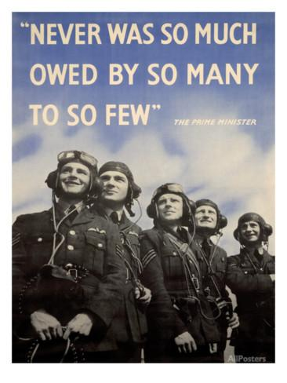
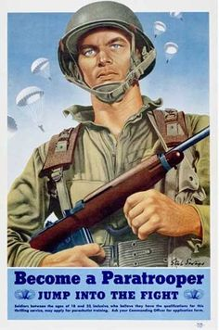

Slide 17
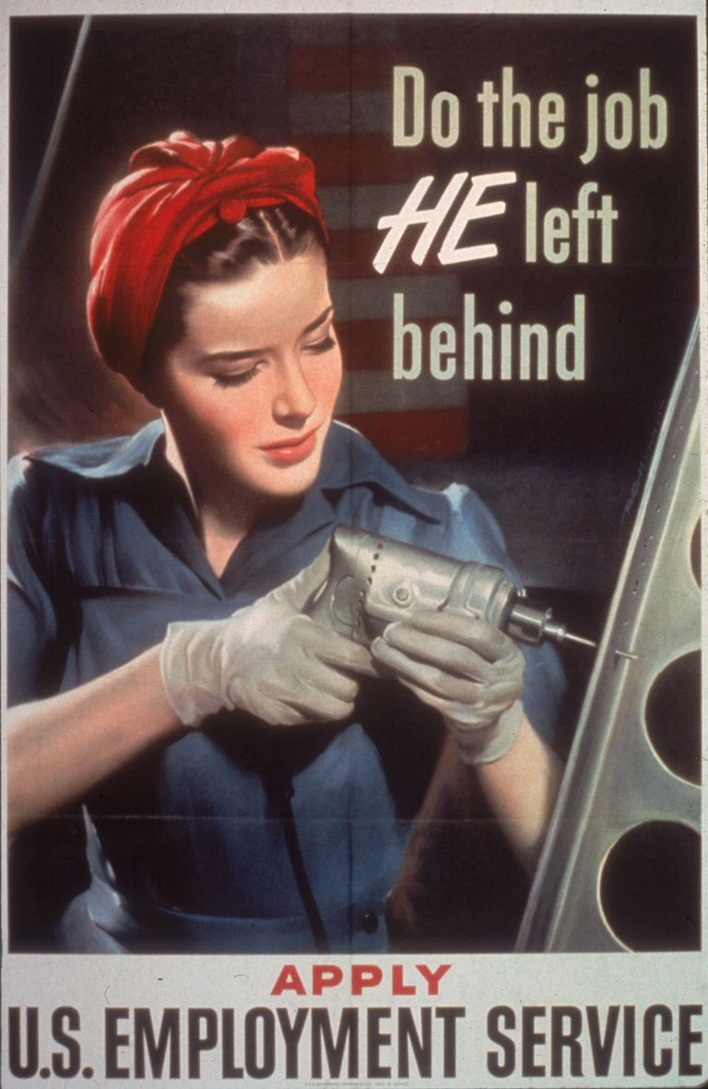

Slide 18
During World War II, the U.S. government’s official messages encouraged women to be _____________________ and _____________________
…. at the same time they implied that women were __________________
and discouraged them from activities like _____________________.

Slide 19
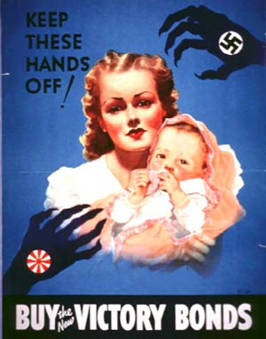
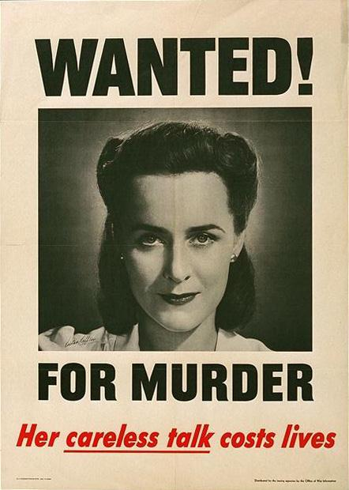

Slide 20
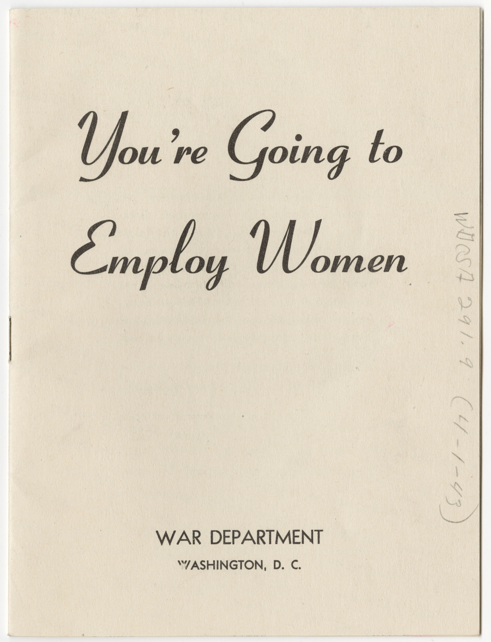

Slide 21
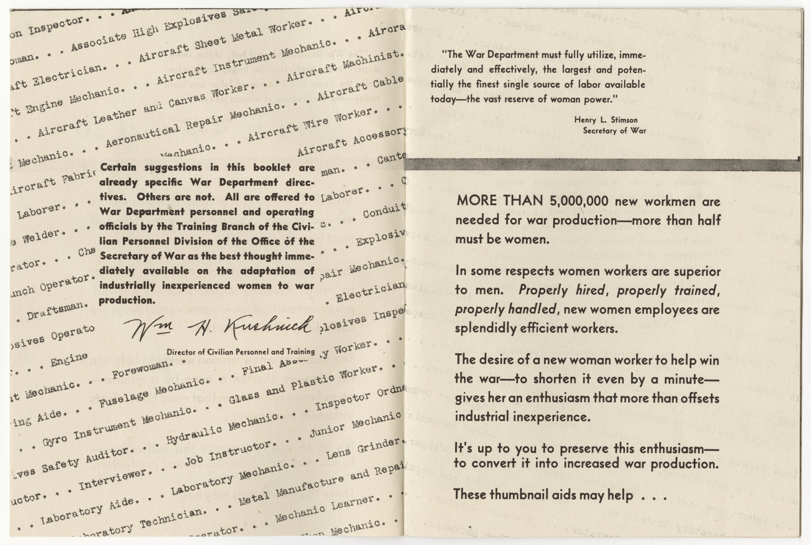

Slide 22
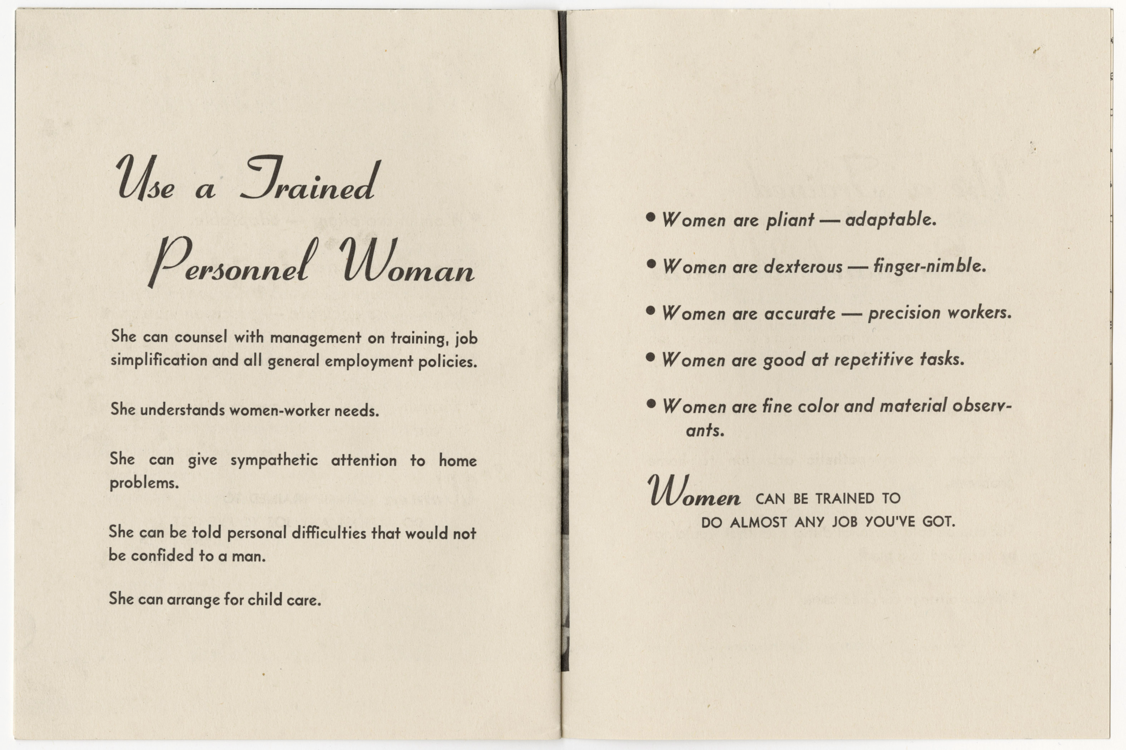

Slide 23
Historical Thinking skills Sourcing Close reading: What choices did the creator of this document make? What do those choices say about the past? How might this document have looked different? Corroborate Contextualize

Slide 24
What do you notice? What words or images stand out? Why? What might those specific words and images tell us about the author’s message and intent?

Slide 26
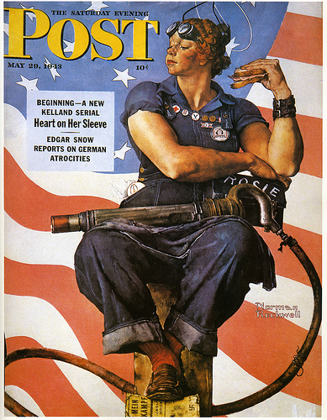

Slide 27
Historical Thinking skills Sourcing Close reading Corroboration: What other texts appeared at this moment? How do they support or complicate this document? What do the disagreements tell us? Contextualize

Slide 28
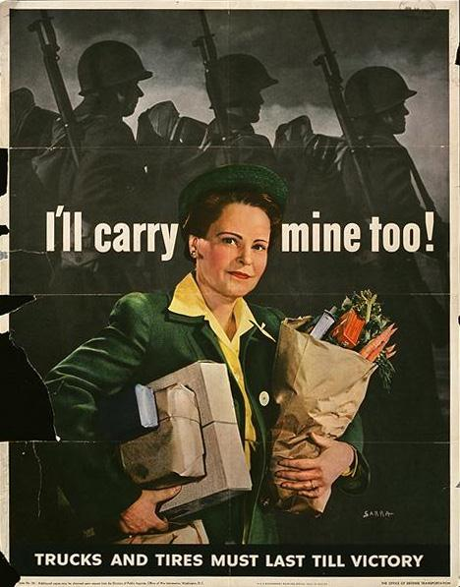

Slide 29
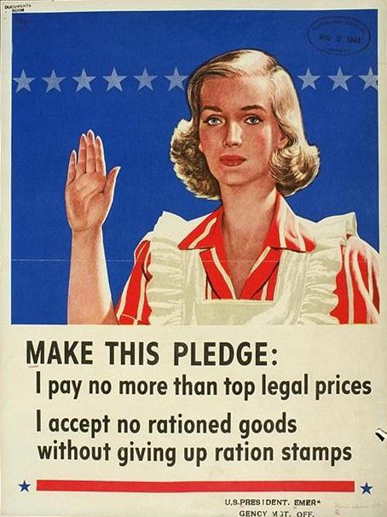

Slide 30
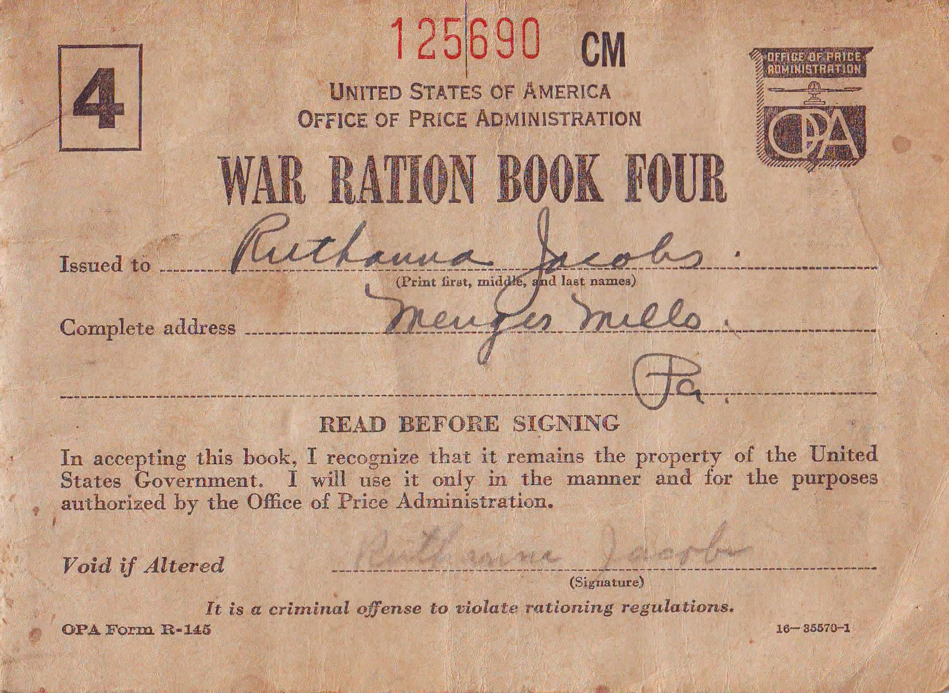

Slide 31
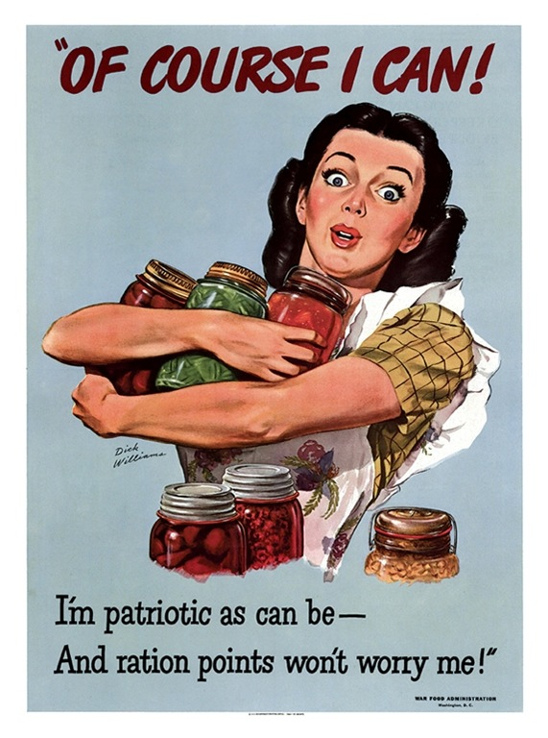

Slide 32
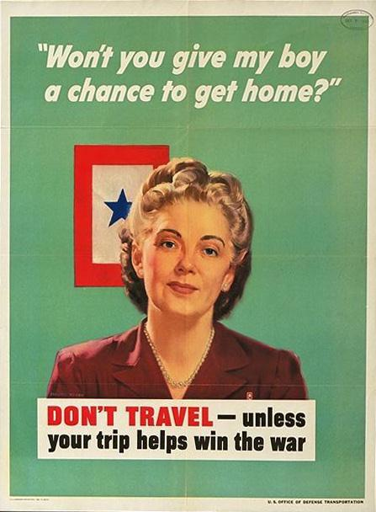

Slide 33
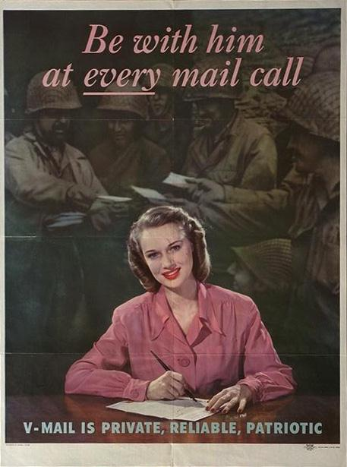

Slide 34
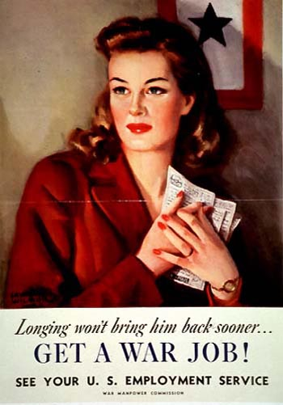

Slide 35
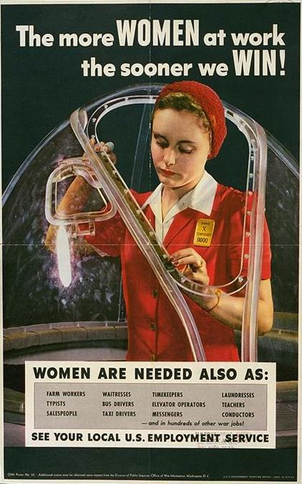

Slide 36
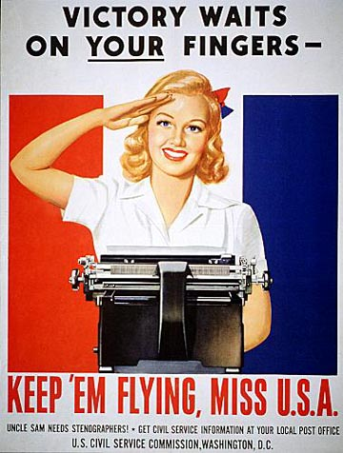

Slide 37
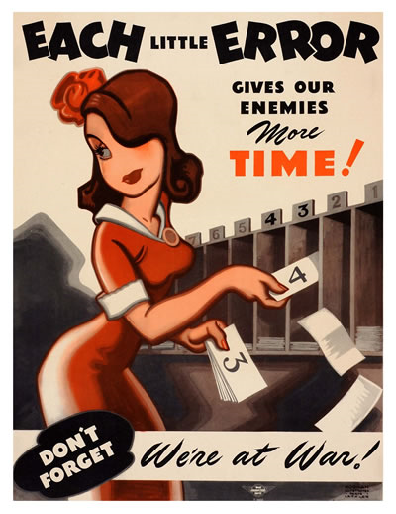

Slide 38
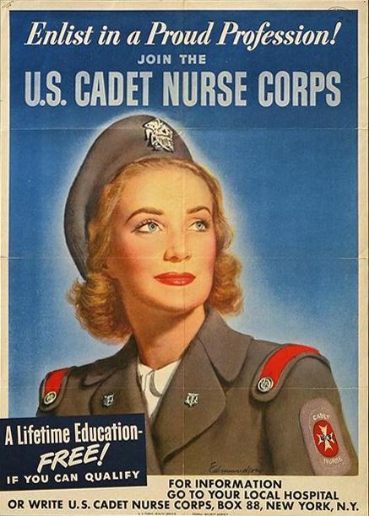

Slide 39
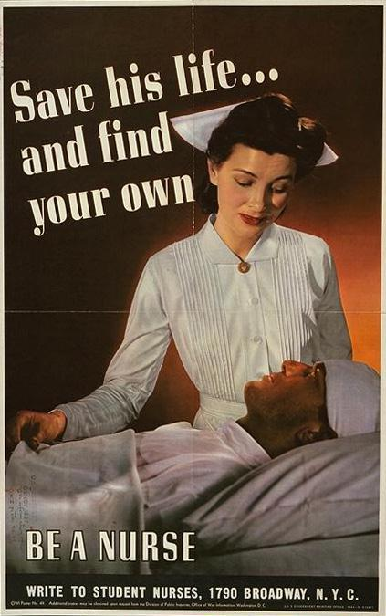

Slide 40
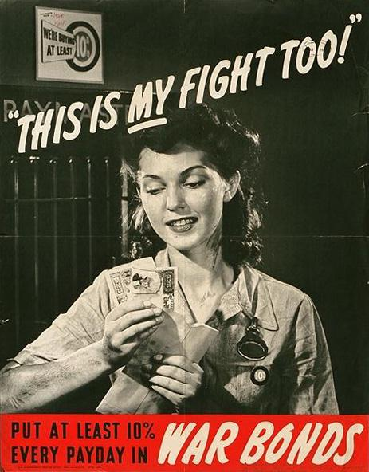

Slide 43
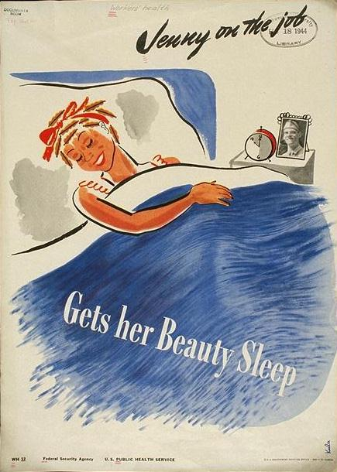

Slide 44
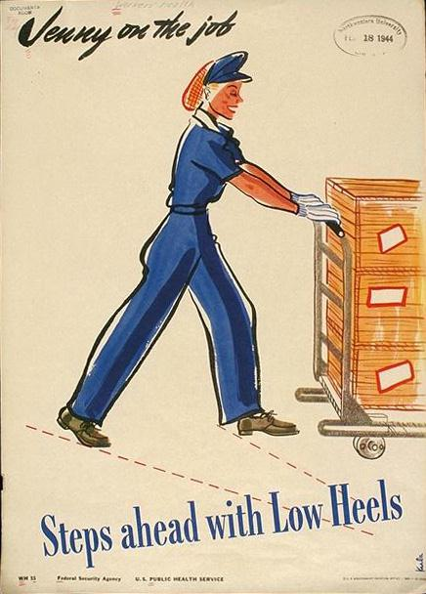

Slide 45
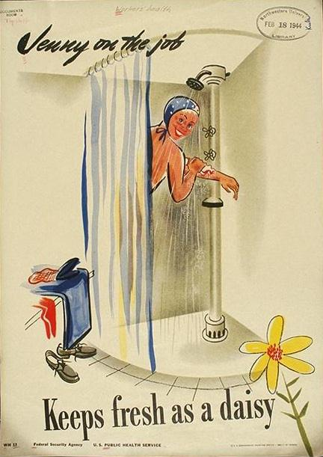

Slide 46
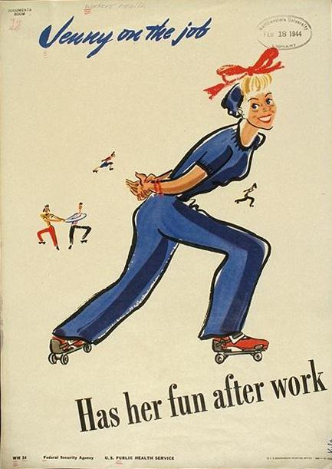

Slide 47
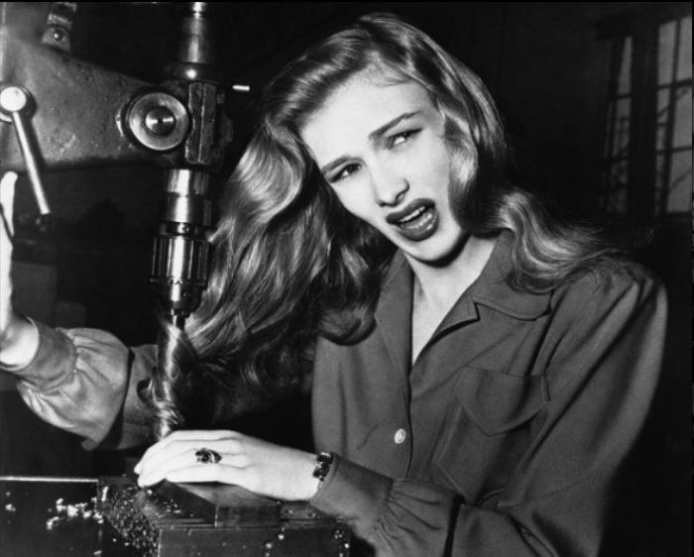

Slide 48
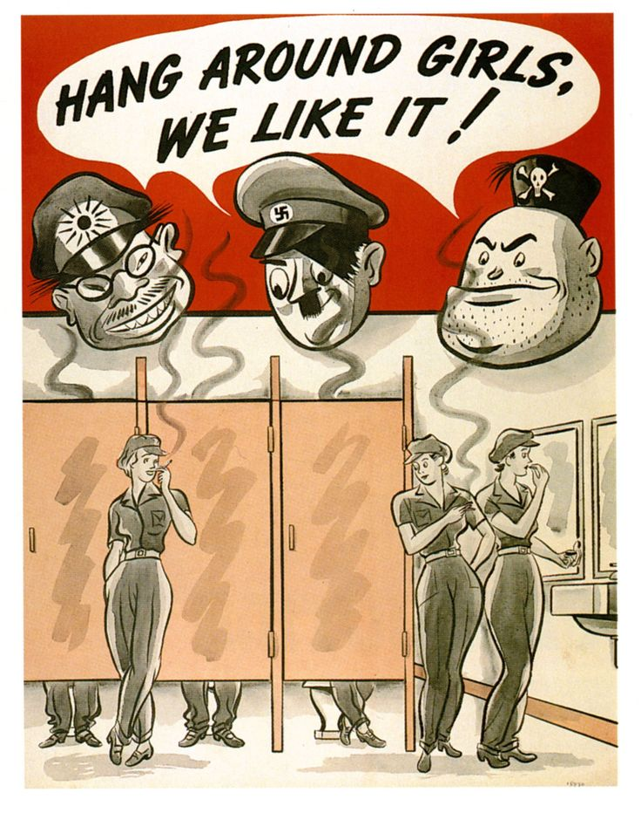

Slide 49
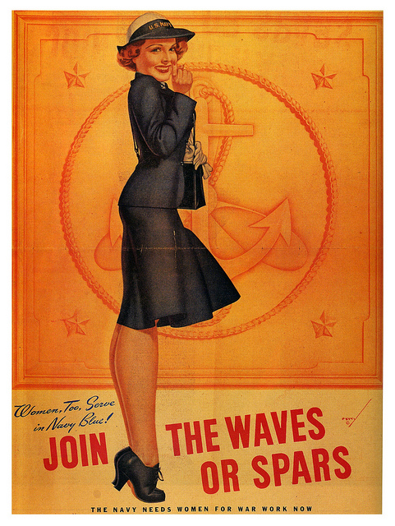

Slide 50
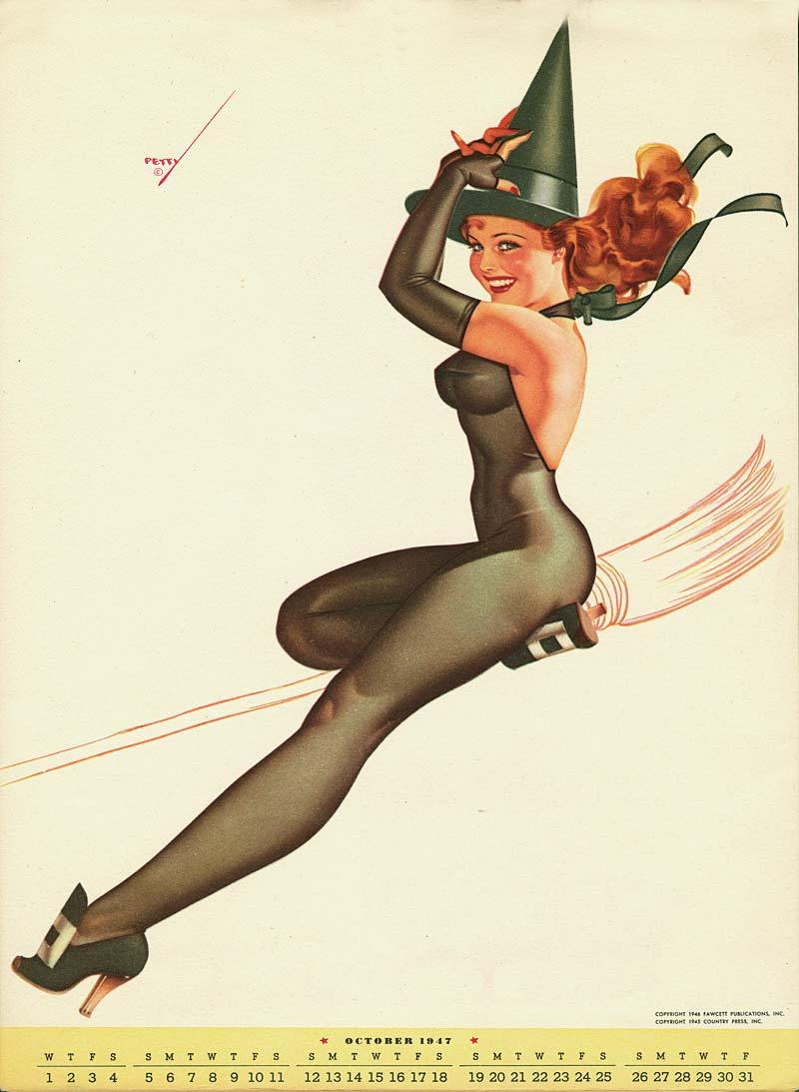

Slide 51
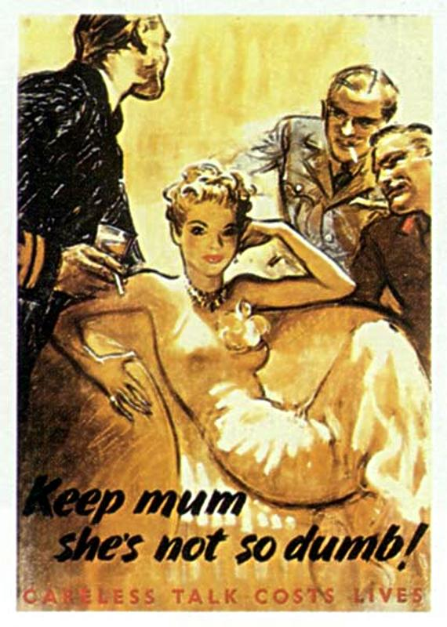

Slide 52
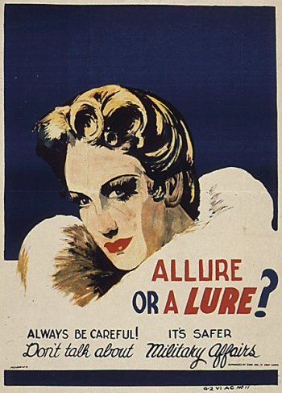

Slide 54
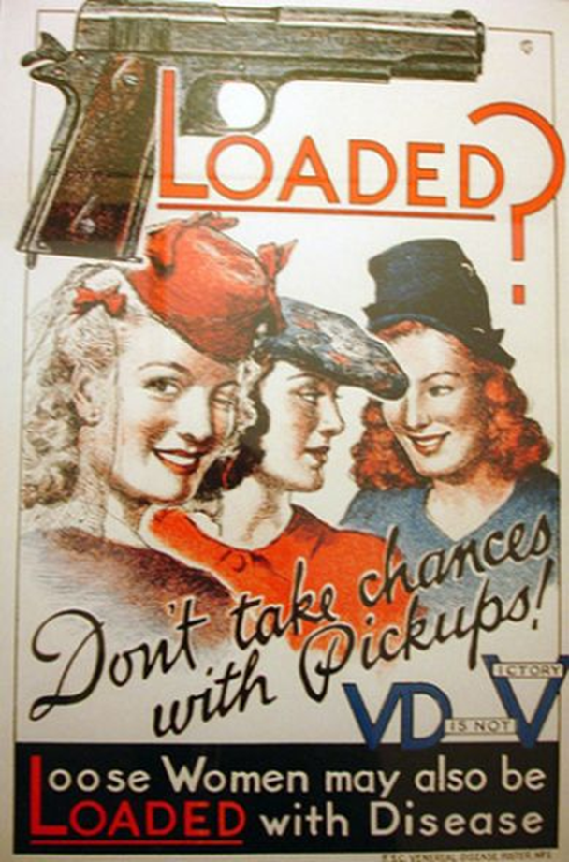

Slide 56
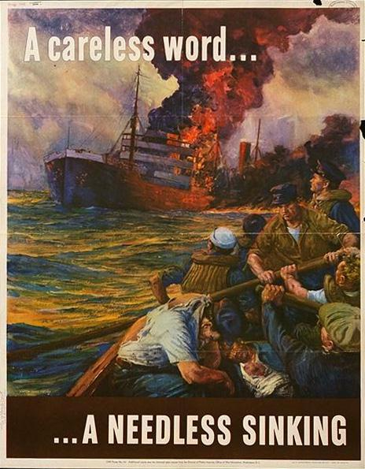

Slide 57
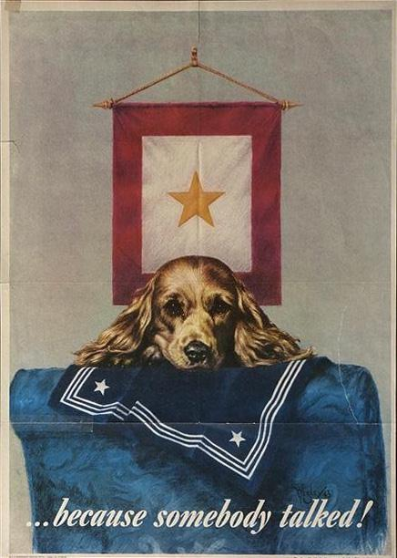

Slide 58
During World War II, the U.S. government’s official messages encouraged women to be _____________________ and _____________________
…. at the same time they implied that women were __________________
and discouraged them from activities like _____________________.

Slide 59
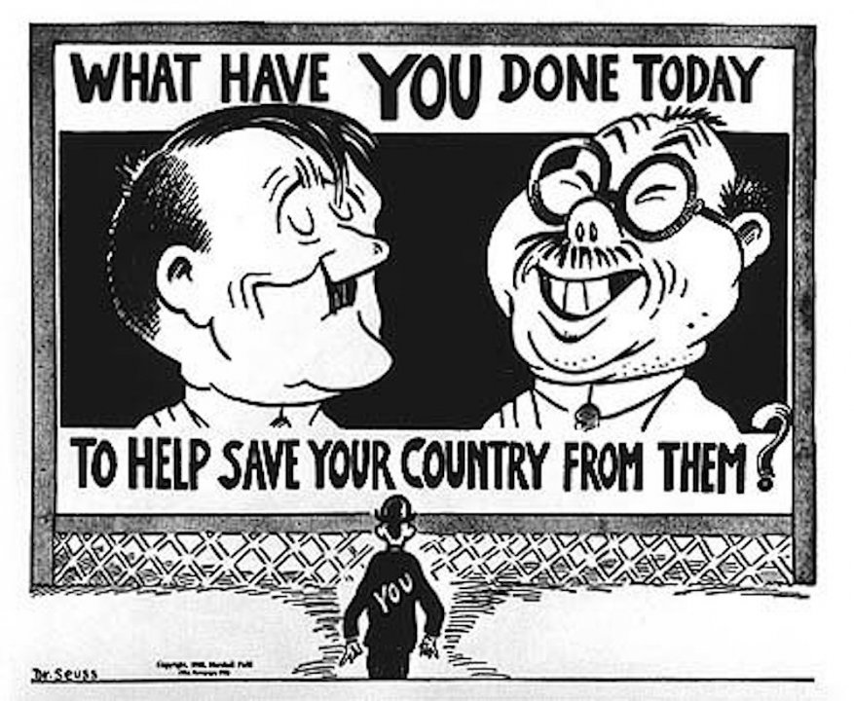

Slide 60
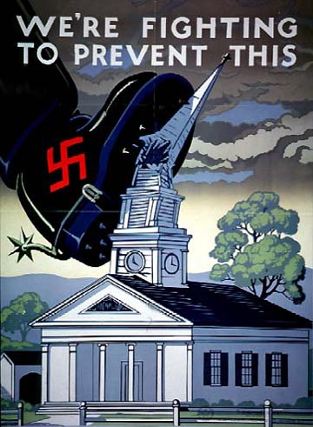
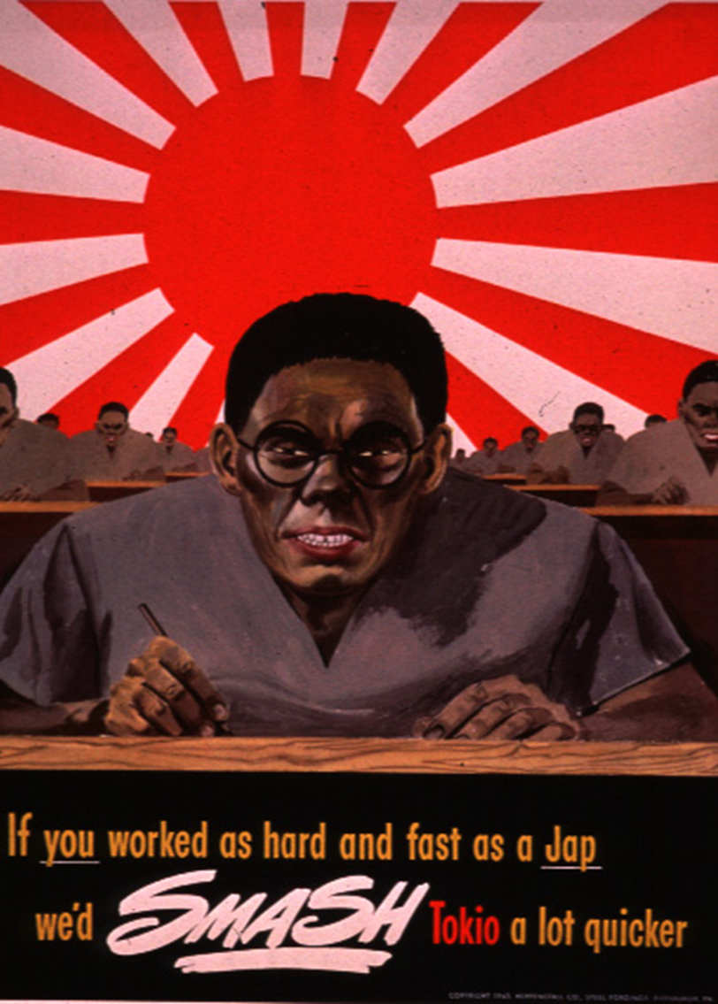

Slide 61
During World War II, U.S. government propaganda the enemy in Europe as _____________________ and _____________________
…. while the Japanese were depicted as _____________________ and
_____________________.

Slide 62
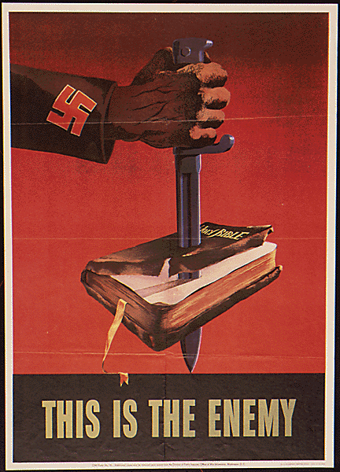

Slide 63
Historical Thinking skills Sourcing Close reading: What choices did the creator of this document make? What do those choices say about the past? How might this document have looked different? Corroborate Contextualize

Slide 64
What do you notice? What words or images stand out? Why? What might those specific words and images tell us about the author’s message and intent?

Slide 66
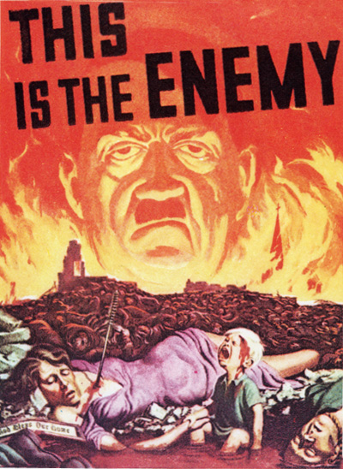

Slide 68
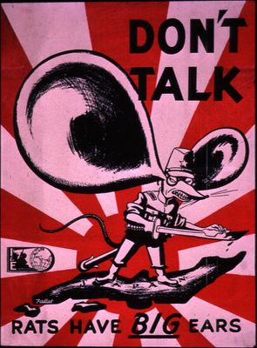

Slide 78
“Throwing in an Extra Charge” December 10, 1941

Slide 81
During World War II, U.S. government propaganda portrayed the enemy in Europe as _____________________ and _____________________
…. while the Japanese were depicted as _____________________ and
_____________________.

Slide 88
questions? suggestions?
Send me an email!
Christopher Hamner
chamner@gmu.edu

